Slide 1
FYP5: Object Detection, Tracking and Suspicious Activity Recognition for Maritime Surveillance using Thermal Vision

Slide 2
Weekly Tasks
Training CornerNet-Lite on SMD
Adding the object detection head to the STA Resnet network and test with different configurations

Slide 3
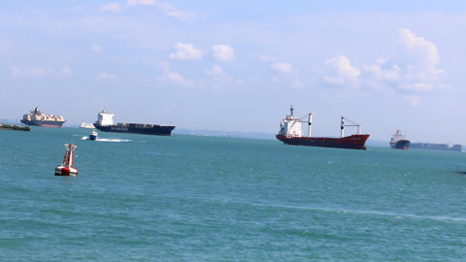
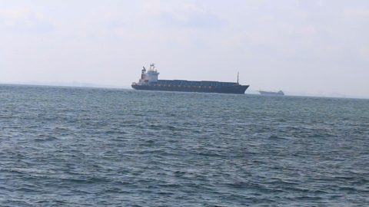
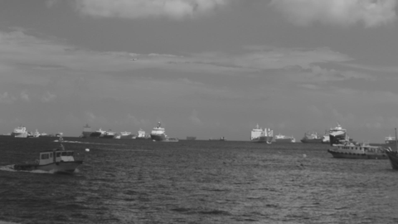
Singapore Maritime Dataset
Have 3 types of videos : Onboard – RGB, Onshore – RGB, NIR – Nera IR
Resolution : 1080 x 1920
Dataset has been captured on various environmental conditions like before sunrise (40 min before sunrise),
sunrise, mid-day, afternoon, evening, after sunset (2hrs after sunset), Haze and Rain
Objects annotated : Ferry, Buoy, Vessel/ship, Speed boat, Boat, Kayak, Sailboat, Swimming person, Flying bird/plane, Other
Onshore image – camera placed on-shore on a fixed platform
Camera – Canon 70D
Onboard image – camera placed on-board on a moving vessel
Camera – Canon 70D
NIR image – camera placed on-shore on a fixed platform
Camera – Canon 70D with Mid-Opt BP800 Near-IR Bandpass filter.

Slide 4
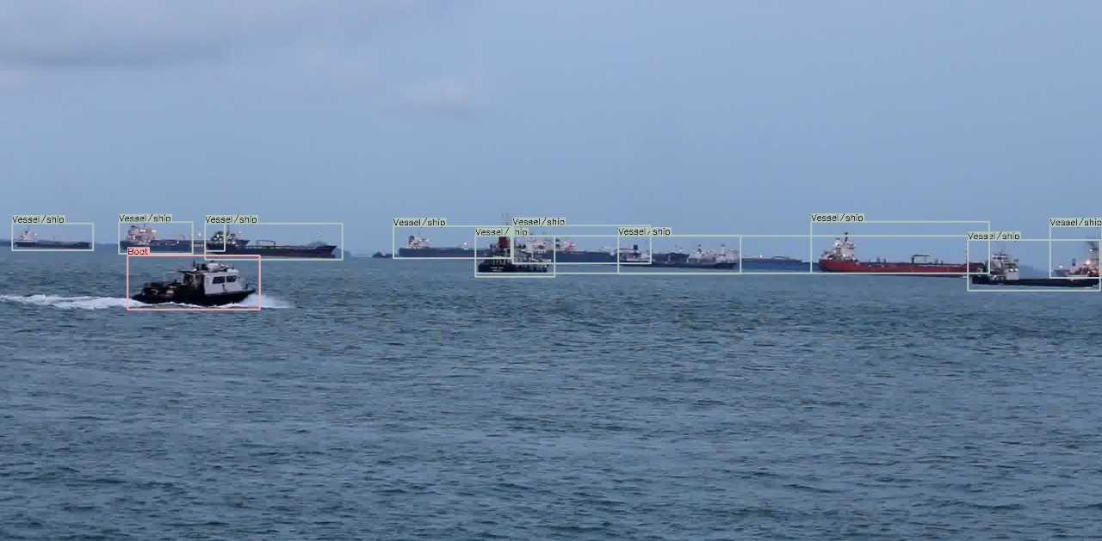
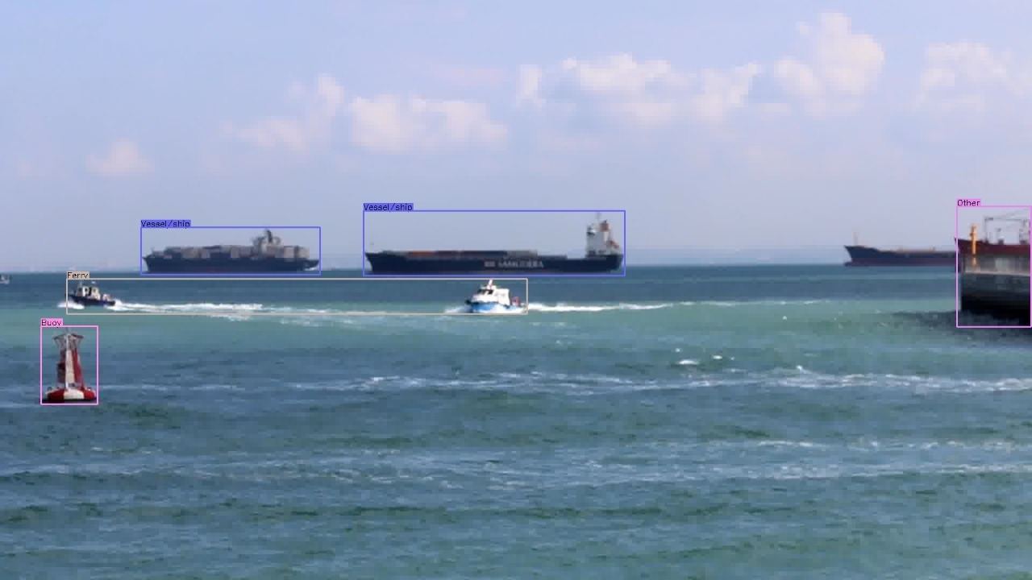
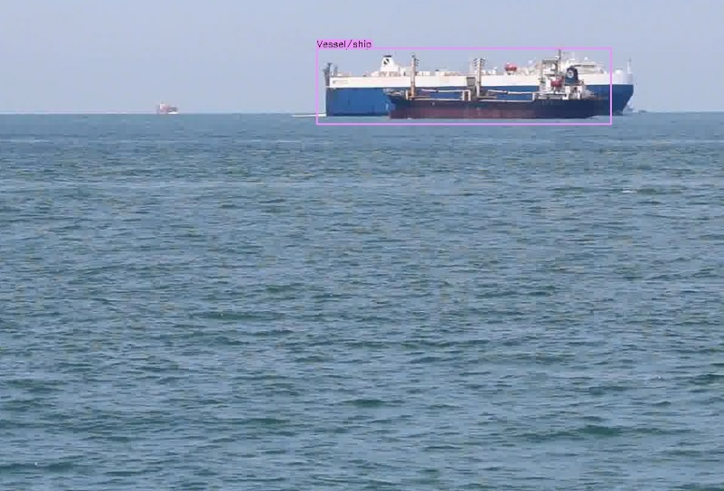
Results Obtained

Slide 5
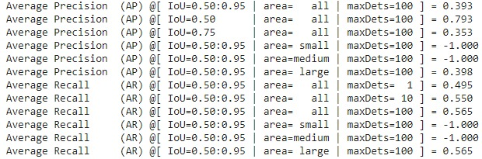
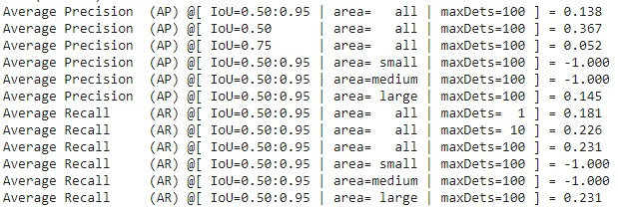
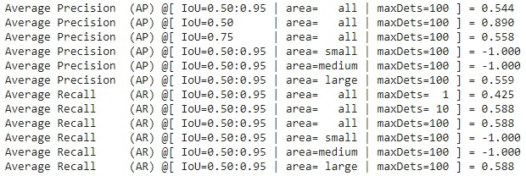
Train
Validation
Test

Slide 6
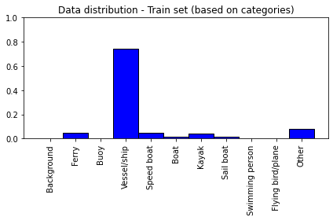
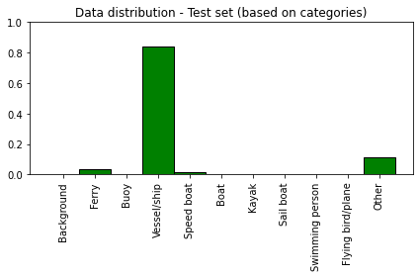
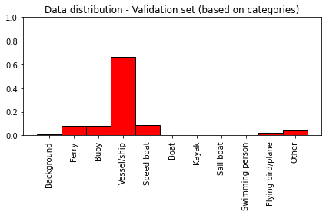
Issues identified with the dataset
Class unbalance between the datasets used for training, validating and testing – issue in the splitting of the dataset
(1) based on the category
Solutions :
Instead of splitting randomly, the splitting can be based on the categories to balance out
Two datasets – Training and Testing will be sufficient
Should investigate multiple object frames as well when splitting the dataset

Slide 7
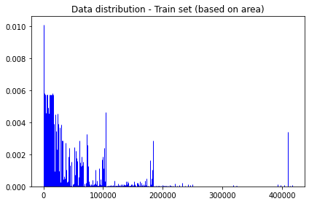
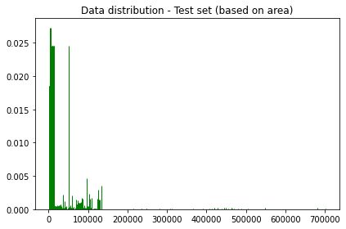
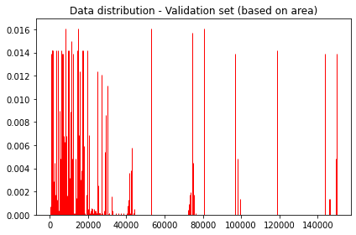
(2) based on object size – number of square pixels
Training and Test datasets have samples that spans from smallest to biggest
In validation, most of the objects occupy less than 200000 square pixels (<9.6% of the total image)
This may cause the lower mAP for validation set compared to test set

Slide 8
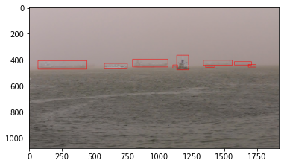
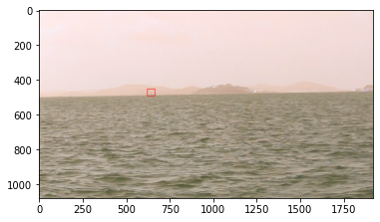
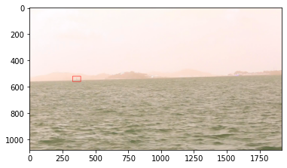
Quality of the samples in the dataset (resolution of original images = 1080 x 1920)
Solutions:
Need to look at whether these are correctly identified with CornerNet-Light we run
If not, shift to CenterNet and see whether the non-detection is due to the low model complexity of the CornerNet-Lite
Look for techniques to deal with small objects – prep-processing techniques to deal with occlusions

Slide 9

Tasks for next week
Train CenterNet on SMD
Fitting the Object Detection head to STA Resnet network

